Slide 1

Development of a Small to Medium Size Dough Kneading Machine
P.M.K.K. Jayasinghe (E/19/161)
Supervised by Dr. Lalith N. Wickramarathna
Department of Mechanical Engineering
Faculty of Engineering
University of Peradeniya
ME420- Mechanical Engineering Individual Research Project
Proposal Presentation
12 December 2024

Slide 2
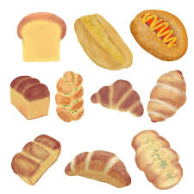
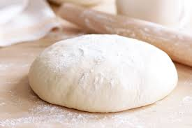
Introduction
Flour based foods,
Staple food and main source of energy for people around the world.
Quality and texture is determined by dough
Dough kneading is used to distributes ingredients, create air bubbles, develop gluten and even out temperature

Slide 3
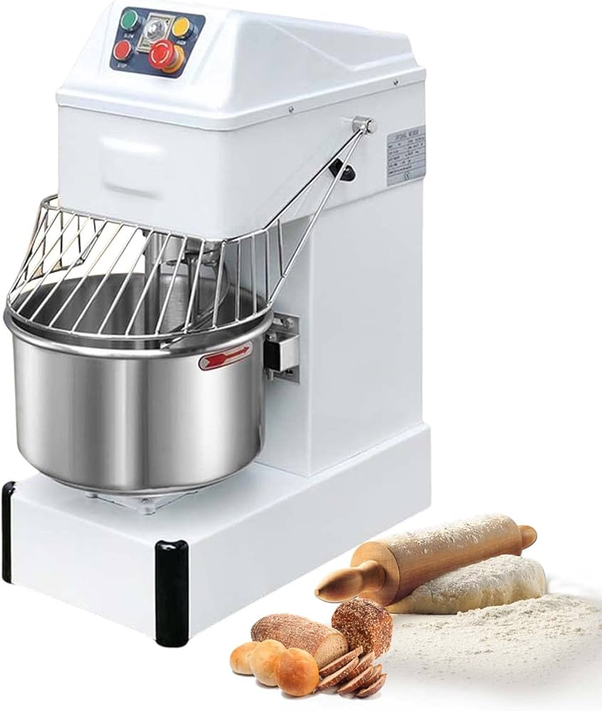
Introduction
Drawbacks of current kneading machines
High cost
Difficulty of operation and maintenance
Operational inefficiency due to bulkiness
limiting their feasibility for small to medium business owners and home usage.
Aim
Design and Development of an affordable, user friendly dough kneading machine

Slide 4
Objectives
Review different kneading operational techniques
Design a kneading machine with an emphasis on affordability, simplicity of operation, and mobility, catering to entrepreneurs of varying technical expertise
Fabrication of the kneading machine
Performance evaluation of the machine’s average capacity, with a specific focus on assessing kneading machine mass and speed efficiencies

Slide 5
Methodology
Search on available dough kneading machines and identify their drawbacks.
Design a model of the machine using 3D modeling software.
Select motors and components required for higher performance of the machine.
Fabricate the prototype.
Test and troubleshoot the machine on different operation conditions.
Performance evaluation of the machine’s average capacity.

Slide 6
Timeline
Week | 1 | 2 | 3 | 4 | 5 | 6 | 7 | 8 | 9 | 10 | 11 | 12 | 13 | 14 | 15 | 16 | 17 | 18 | 19 | 20 | 21 | 22 | 23 | 24 | 25 | 26 | 27 | 28 | 29 | 30
Project topic selection
Project proposal presentation
Literature review on dough kneading
Feasibility study on the machine
Design the model of the machine
Video presentation and viva
Components selection
Fabrication of the machine
Demonstration
Testing and trouble shooting
Oral presentation
Performance evaluation
Viva with demonstration
Report / Article submission

Slide 7
References
Ojo, O., Oyerinde, A., Bamisaye, O. S., Adewole, J., & Adepoju, T. (2023). Development of dough kneading machine for small and medium-sized enterprises. Journal of Applied Research in Technology & Engineering, 5(1), 23–31. https://doi.org/10.4995/jarte.2024.20210
Flour Market Size, Share, Growth & Forecast 2032 | Fact.MR. (2022). Factmr.com. https://www.factmr.com/report/2248/flour-market
Wang, W., Zhou, X., Li, W., Liang, J., Huang, X., Li, Z., Zhang, X., Zou, X., Xu, B., & Shi, J. (2024). Real-Time Monitoring of Dough Quality in a Dough Mixer Based on Current Change. Foods, 13(3). https://doi.org/10.3390/foods13030504
Cappelli, A., Bettaccini, L., & Cini, E. (2020). The kneading process: A systematic review of the effects on dough rheology and resulting bread characteristics, including improvement strategies. Trends in Food Science & Technology, 104, 91–101. https://doi.org/10.1016/j.tifs.2020.08.008
Venturi, M., Cappelli, A., Pini, N., Galli, V., Lupori, L., Granchi, L., & Cini, E. (2022). Effects of kneading machine type and total element revolutions on dough rheology and bread characteristics: A focus on straight dough and indirect (biga) methods. LWT, 153, 112500. https://doi.org/10.1016/j.lwt.2021.112500

Slide 8
Thank you

